Slide 1
Data Discretization

Slide 2
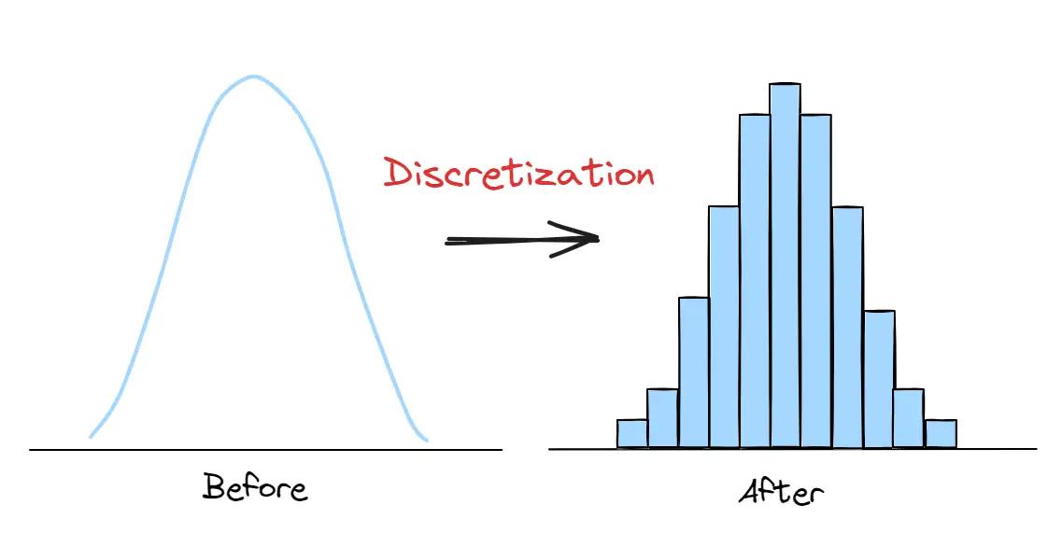
What is Data Discretization?
Many machine learning models, particularly those relying on categorical variables, cannot directly process continuous values.

Slide 3
What is Data Discretization?
Discretization helps overcome this limitation by segmenting continuous data into meaningful bins or ranges.

Slide 4
What is Data Discretization?
For example, decision trees and Naïve Bayes classifiers often perform better with discretized data, as they reduce the dimensionality and complexity of input features.

Slide 5
What is Data Discretization?
Discretization helps uncover patterns or trends that may be obscured in continuous data, such as the relationship between age ranges and purchasing habits in customer analytics.

Slide 6
What is Data Discretization?
Discretization is the process of converting continuous data or numerical values into discrete categories or bins and associating with each bin some specific data value or conceptual labels.

Slide 7
What is Data Discretization?
Instead of dealing with exact values, discretization groups the data into ranges and helps algorithms perform better especially in classification tasks.

Slide 8
Continuous vs Discrete Data
A set of data is said to be continuous if the values belonging to the set can take on any value within a finite or infinite interval | A set of data is said to be discrete if the values belonging to the set are distinct and separate
Measured
Counted

Slide 9
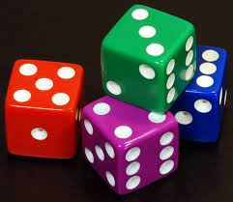
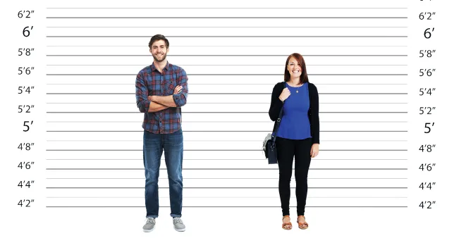
Continuous vs Discrete Data
Measured
Counted
Height of a person can range anywhere between 0 to 7 feet tall
Dice rolls can only be 1 or 2 or 3 or 4 or 5 or 6

Slide 10
Continuous vs Discrete Data
Measured | Counted
Height of a person | Number of persons living in a house
Length of a leaf | Number of dry leaves in a plant
Speed of a vehicle | Number of vehicles caught for speeding in a highway

Slide 11
Human Age Discretization
Continuous data:
1, 77, 9, 4, 70, 11, 42, 17, 13, 18, 19, 31, 33, 36, 14, 44, 46, 7, 74, 78, 5
Sorted Data:
1, 5, 9, 4, 7, 11, 14, 17, 13, 18, 19, 31, 33, 36, 42, 44, 46, 70, 74, 78, 77
Step 1: Sort the continuous values in ascending order

Slide 12
Human Age Discretization
Sorted Data:
1, 5, 9, 4, 7, 11, 14, 17, 13, 18, 19, 31, 33, 36, 42, 44, 46, 70, 74, 78, 77
1, 5, 9, 4, 7 | 11, 14, 17, 13, 18, 19 | 31, 33, 36, 42, 44, 46 | 70, 74, 78, 77
Step 2: Evaluate a cut point for splitting

Slide 13
Human Age Discretization
1, 5, 9, 4, 7 | 11, 14, 17, 13, 18, 19 | 31, 33, 36, 42, 44, 46 | 70, 74, 78, 77
Child | Young | Mature | Old
1, 5, 9, 4, 7 | 11, 14, 17, 13, 18, 19 | 31, 33, 36, 42, 44, 46 | 70, 74, 78, 77
Step 3: Split or merging intervals of continuous values according to some defined criterion

Slide 14
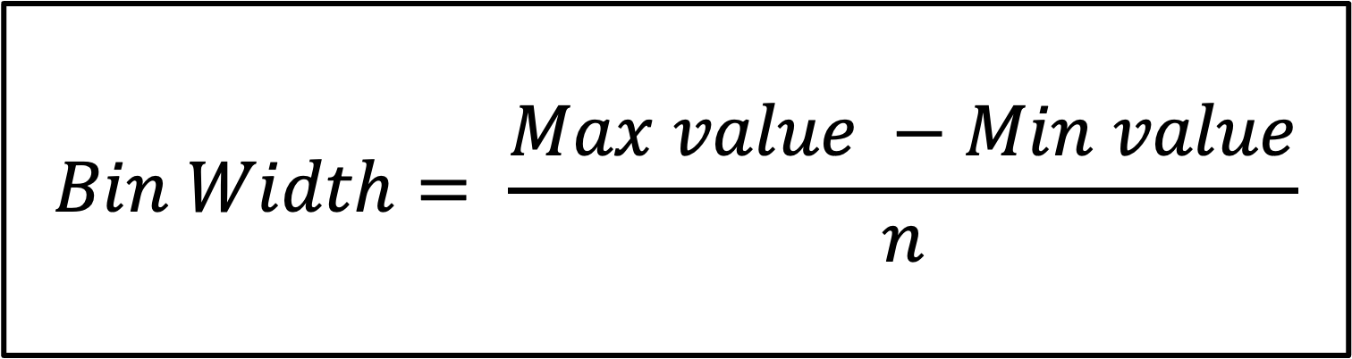
Equal Width Binning
This technique divides the entire range of data into equal-sized intervals. Each bin has an equal width, determined by dividing the range of the data into n intervals.
$$Bin Width= \frac{Max value −Min value}{n}$$

Slide 15
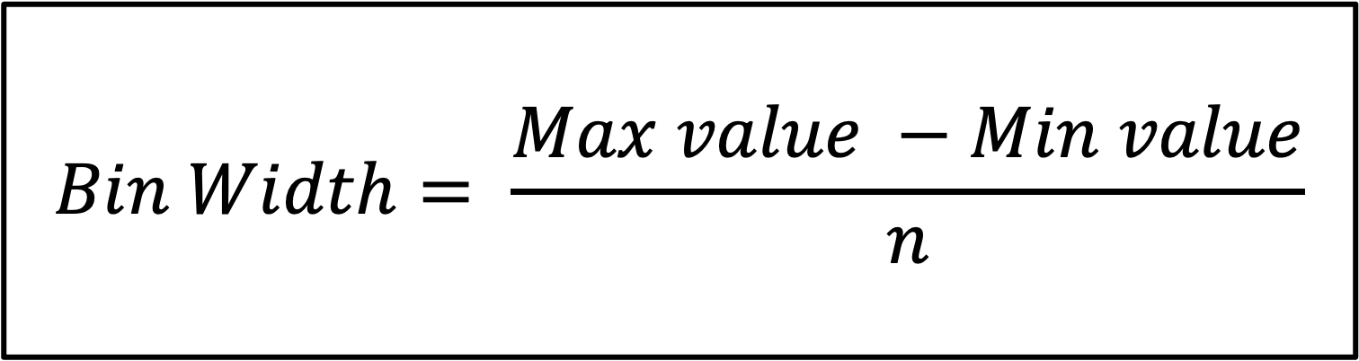
Equal Width Binning
$$Bin Width= \frac{Max value −Min value}{n}$$
Bin width indicates how wide each bin is. It tells you the numerical range covered by each bar in a histogram.

Slide 16
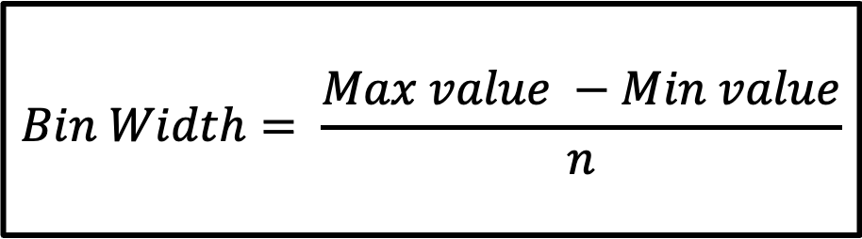
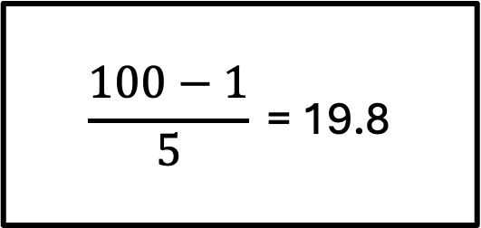
Equal Width Binning
If your data ranges from 1 to 100 and you divide it into 5 bins, each bin must cover:
$$Bin Width= \frac{Max value −Min value}{n}$$
$$\frac{100−1}{5}\text{ = 19.8}$$

Slide 17
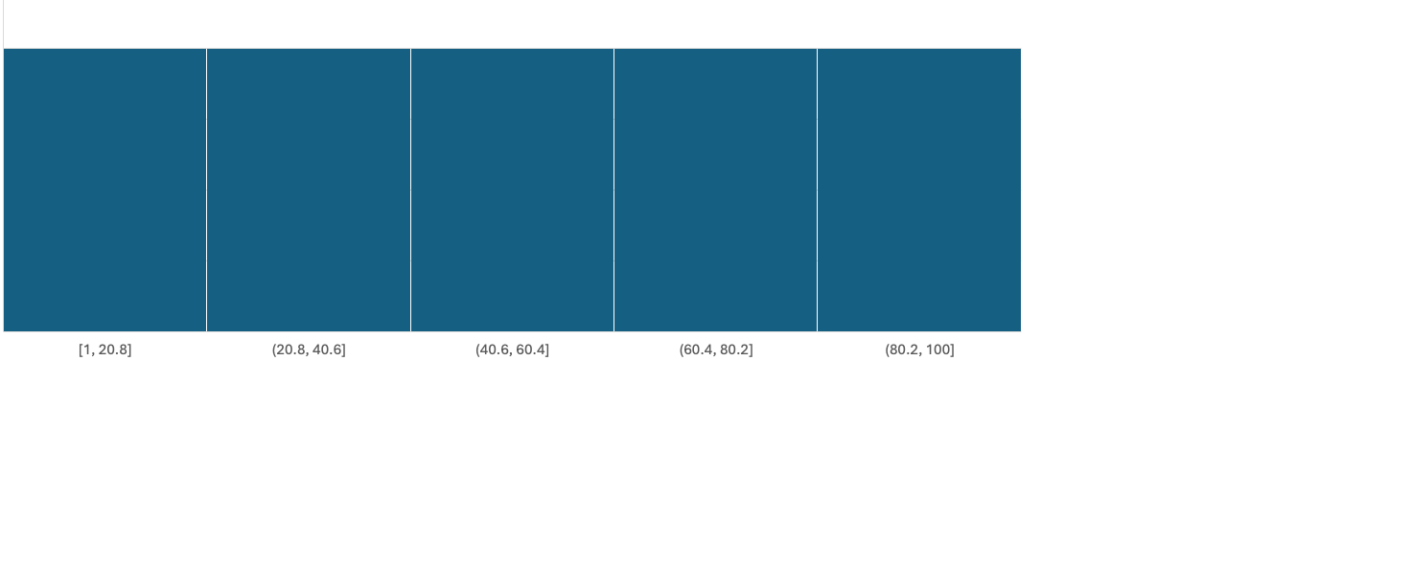
Equal Width Binning

Slide 18
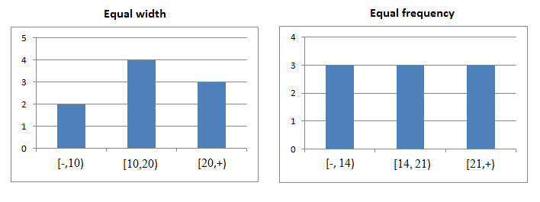
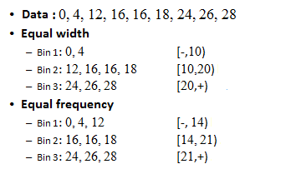
Equal Width Binning

Slide 19
Equal Width Binning
For example, if you have age data of
0,4,12,16,16,18,24,26,28
Bin 1: 0,4
Bin 2: 12,16,16,18
Bin 3: 24,26,28

Slide 20
Equal Frequency Binning
This method divides the data so that each interval has the same number of data points. For example, if you have 100 data points, you might divide them into 5 intervals, each containing 20 data points.

Slide 21
Equal Frequency Binning

Slide 22
Summary
Normalizing your data is an essential part of machine learning.
You might have an amazing dataset with many great features, but if you forget to normalize, one of those features might completely dominate the others. It’s like you’re throwing away almost all of your information! Normalizing solves this problem.

Slide 23
Summary
Having features on same scale that can contribute equally to the result. It can enhance the performance of machine learning algorithms.
If you don't scale features then large scale variables will dominate the small scale features.

Slide 24
Summary
Min-max normalization: Guarantees all features will have the exact same scale but does not handle outliers well.
Z-score normalization: Handles outliers, but does not produce normalized data with the exact same scale.

Slide 25
References
https://jisooleeworks.github.io/blog-site/2022/09/09/feature-scaling-min-max-z-score.html
https://vinaypaspula.substack.com/p/min-max-normalization-and-z-score-normalization-550988c2a990?utm_campaign=post&utm_medium=web

